Slide 1


11/7/18 Meeting Update
Hoping the turtle really wins the race

Slide 2
General
Power:
(1) Have data
(2) Have researched converters, LDOs, and fuel gauges
Comms:
(1) Bluefruit BLE generally working
Sensor:
(1) Have I2C working for temp/humidity sensor
(2) Have current measurements for sensor

Slide 3
Power
Data- We have unaliased data, but can’t really filter, the max values are the important ones.
Current into battery is >5mA in lamplight
Battery charges quickly, then linearly
Data presented is over about 8 hours. Getting to 4.2 V will require a lot of data or sunlight
Plans- BQ27426 (Fuel Gauge), TPS6303x (Buck-Boost Converter), LDOs (BH33M0AWHFV-TR , MAX664ESA+)
Fuel Gauge communicates with MSP
Buck-Boost converters create a 3.4V line and a 5.1V line
LDOs bring those lines down to a much cleaner 3.3V and 5V
Our hope is to have parts in and a prototype system kinda working by next weekend

Slide 4
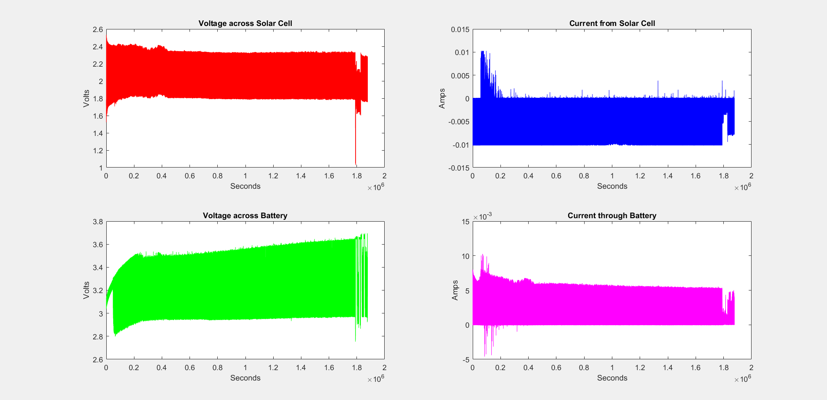
Power

Slide 5
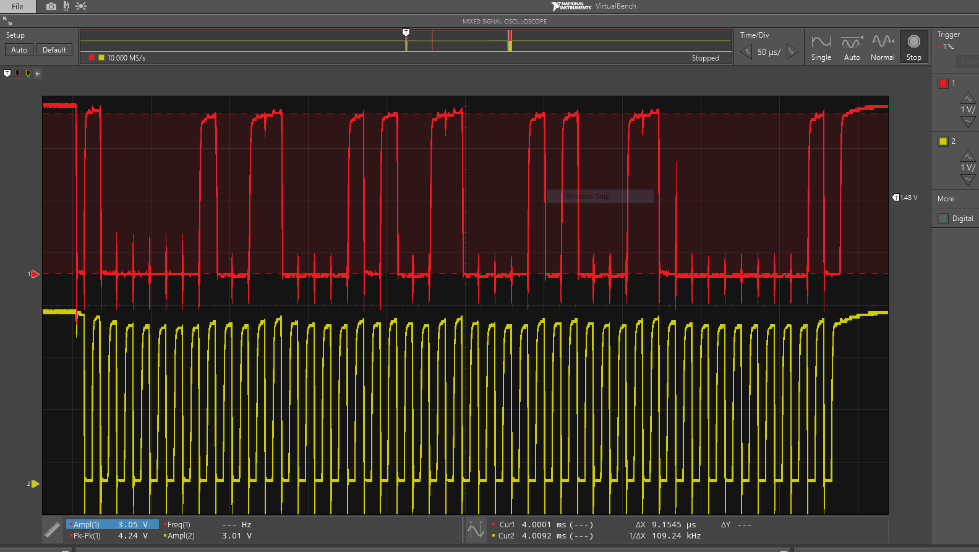
Sensor - Coding
Temperature/humidity sensor
I2C up and working - viewed data and clock lines on oscilloscope
Byte 1: Device address and read bit (0x40 and a 1)
Bytes 2-3: Temperature value (came out as 23℃)
Bytes 4-5: Humidity value (63%)
Next up:
Save data to FRAM
Transition from polling to interrupts

Slide 6
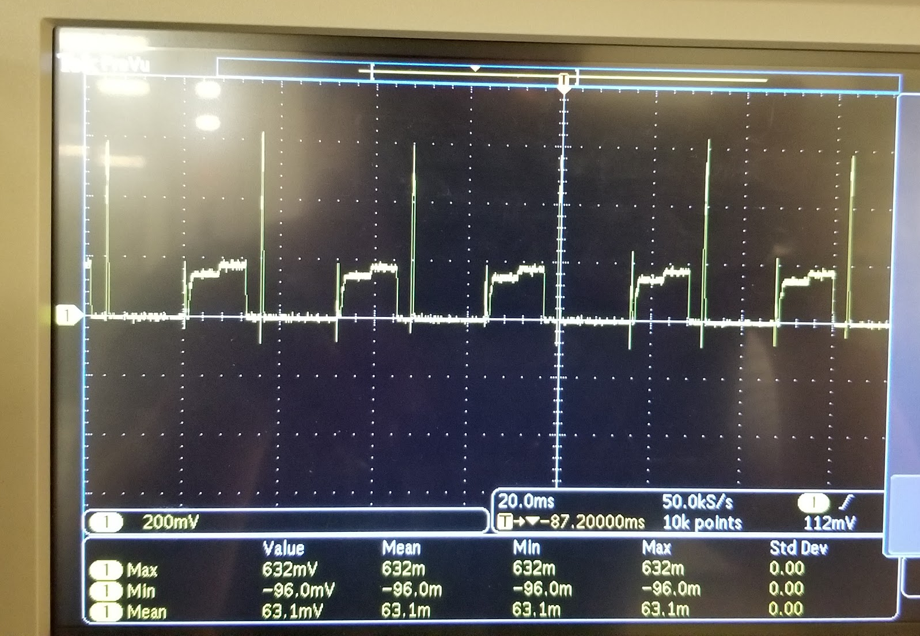
Sensor - Power performance
 | Current (uA)
Avg (over 40ms) | 66
Peak | 528
t1 | 176
t2 | 144
peak
t1
t2
I2C Polling
Measured over 1kΩ resistor

Slide 7
Next time on CharIoT
System diagram
Prep for 1st prototype rollout
Include data flow, power lines, and control signals
Sensor
Trigger data acquisition using timer
I2C polling → interrupt based (utilizing low power modes)
Save data to FRAM
Bluetooth
TX based on external pin enable (this will come from fuel gauge reading)
Power
Order Buck Boost converters & LDOs to provide power rails
Order fuel gauge to provide system monitoring
Notes:
1.58 = 3e-6*86400*365/60

